Slide 1
Simple Multi-threaded Chat Server
Network Programming Final Project
Nguyễn Tiến Dũng
- 23BI14116
Phạm Võ Toàn Đức
- 23BI14105
Đoàn Xuân Bách
- 23BI14059
Đào Quang Anh
- 23BI14031
Group 4 – A1 - Multi-Client Chat Applications
Lê Nam Anh
- 23BI14029
Nguyễn Hoàng An
- 23BI14006
Write your message

Slide 2
Table of contents
01
02
03
04
Introduction
System Architecture
Server-Side Implementation
Client-Side Implementation
05
06
Data Structures and Algorithms
Client Usage Examples

Slide 3

Introduction
1
11:25 AM
Write your message

Slide 4
System Architecture
02
9:14 AM
10:25 AM
1:17 PM
The system follows a client-server architecture.
Write your message

Slide 5
System Architecture
11:25 AM
Sever
The central component responsible for managing client connections, chat rooms, message broadcasting, and file transfers.
12:45 PM
Clients
The application that users interact with to connect to the server, send/receive messages, and transfer files.

Slide 6
Server-Side Implementation
03
9:14 AM
10:25 AM
1:17 PM
Core Functionality of Sever-side
Write your message

Slide 7
Core Functionality
Connection Handling: The server uses the socket library to listen for incoming client connections. The threading library is used to create a new thread for each client, allowing for concurrent handling of multiple clients.
User Management: Clients are prompted to enter a username upon connection. The server stores the username and the client's current room.
Room Management: The server allows the creation, joining, and leaving of chat rooms. It maintains a list of users in each room.
Message Broadcasting: The server broadcasts messages to all users in the same room.
Command Handling: The server processes commands entered by users (e.g., /help, /join, /create).
File Transfer: The server facilitates file transfers between clients using a chunking mechanism and JSON packets to coordinate the transfer.
Private Messaging: The server supports private messages to specific users.
Message History: The server maintains a history of recent messages in each room, allowing users to recall previous messages.
Write your message

Slide 8
Client-Side Implementation
04
9:14 AM
10:25 AM
1:17 PM
Core Functionality of Client-side
Write your message

Slide 9
Core Functionality
Connection: The client connects to the server using the socket library.
Sending Messages: The client sends text messages and commands to the server.
Receiving Messages: The client receives and displays messages from the server.
File Sending: The client allows users to select a file and send it to other users using the /sendfile command. It breaks the file into chunks and sends them to the server.
File Receiving: The client receives file chunks from the server, reconstructs the file, and saves it to the "downloads" directory.
Private Messaging: The client supports sending and receiving private messages.
User Highlighting: The client highlights usernames with different colors to improve readability.
Write your message

Slide 10
Client Usage Examples
05
9:14 AM
10:25 AM
1:17 PM
Examples that illustrate common interactions with the chat client.
Write your message

Slide 11
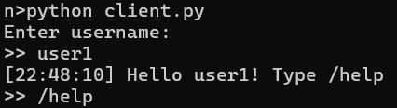
5.1. Connecting and Setting Username
Upon starting the client, the server prompts for a username. In this example, the user enters "an". The server acknowledges the connection and displays a welcome message along with the /help command.
Write your message

Slide 12
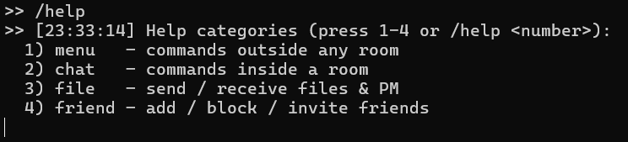
5.2. Viewing Available Commands
The user enters the /help command to see a list of available commands supported by the server.
Write your message

Slide 13


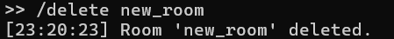
5.3. Outside the room (chat)
/create <name> command to create a new chat room.
/join <name> command to enter the chat room.
/rename <new> command to change name
/delete <name> command to delete room
/count command for the number of user per room
/online command for the total online users
/quit command to log out
Write your message

Slide 14

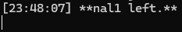
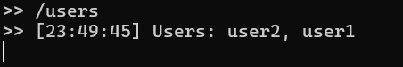
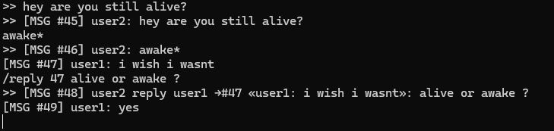
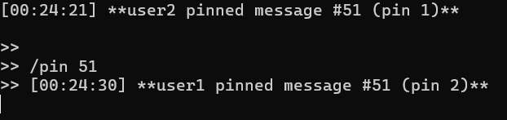
5.4. Inside the room (chat)
/leave command to leave the current chat room.
/users command to list all users in the room.
Users in the same chat room can send and receive messages. Each message is prefixed with a message ID and the sender's username.
/recall <id> command to recall a message
/reply <id> <txt> command to reply a message
/pin, /unpin <id> command to pin and unpin a message
/forward <id> <r> command to forward message to room r
/msg @User <txt> for private message
/invitefriend <usr> to invire friend to room
Write your message

Slide 15
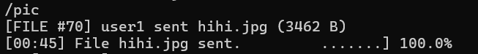
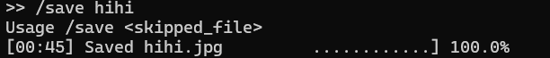
5.5. Send/Receive Files
Users in the same chat room can send, save and open files. Each files is prefixed with a same ID with the message and the sender's username.
/open <file> and /save <file> are used to save and open file
File can be sent in multiple formats:
/pic to send image (.jpg/.png)
/mp3 to send audio (.mp3/.wav)
/mp4 to send video (.mp4)
/text to send text file (.txt)
/pdf to send PDF document (.pdf)
/gif <url> to fetch and send GIF
Write your message

Slide 16
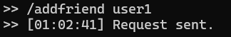
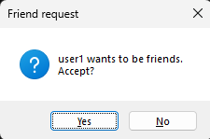



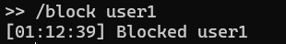
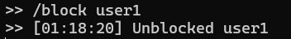
5.6. Friend Management
Users in the same sever can add friend and accept requests from others through username or pop up request (using /addfriend <usr> and /acceptfriend <usr>)
/myfriends command to check your friendlist
/unfriends command to remove friend from any users
/block command to block user
Write your message

Slide 17
06
Data Structures and Algorithms
10:25 AM
9:14 AM
Write your message

Slide 18
Data Structures and Algorithms
11:25 AM
Dictionaries
Dictionaries (clients, user_rooms, rooms) are used extensively for efficient lookups.
12:45 PM
Deques
Deques (history) provide efficient insertion and removal from both ends, making them suitable for managing message history.
1:45 PM
Threading
The threading library is crucial for handling multiple clients concurrently, ensuring that the server remains responsive.

Slide 19
Data Structures and Algorithms
11:25 AM
JSON
JSON is used for structured data exchange, particularly for file transfer metadata and private messages.
12:45 PM
Base64
Base64 encoding is used to transmit binary file data within JSON packets.
1:45 PM
File Chunking
Files are broken down into smaller chunks for transmission, improving reliability and allowing for progress tracking.

Slide 20
Potential Improvements
The code could benefit from more robust error handling
For a large number of users, the server's architecture might need to be optimized
The current implementation lacks security features. Adding these would be essential for a production system.
11:30 AM
11:10 AM
11:39 AM
Error Handling
Scalability
Security
Downloaded files are saved in a local "downloads" directory. A more sophisticated file management system could be implemented.
Persisting messages to a database would allow for message retrieval after the server restarts.
A more robust protocol could be defined for communication to handle various scenarios and data types more effectively.
11:32 AM
11:54 AM
11:34 AM
Message Persistence
File Storage
Protocol

Slide 21
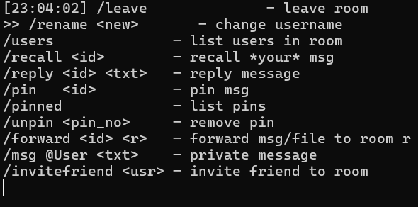
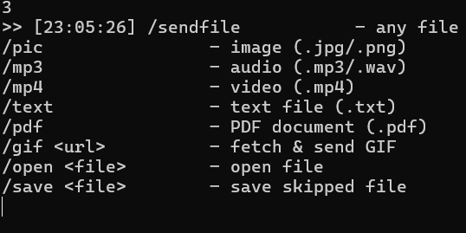
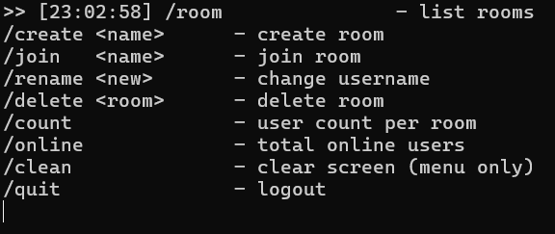
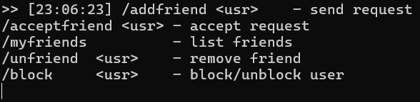
5.2. Viewing Available Commands
The user enters the /help command to see a list of available commands supported by the server.
Inside the room
(chat)
Send/receive Files
Outside the room
(menu)
Friends Management
Write your message

Slide 22
Product overview
Mercury
Mercury is the closest planet to the Sun
Neptune
Neptune is the farthest planet from the Sun
Venus
Venus is the second planet from the Sun
Jupiter
Jupiter is the biggest planet of them all

Slide 23
Potential Improvements
Mercury
Mercury is the closest planet to the Sun
Neptune
Neptune is the farthest planet from the Sun
Venus
Venus is the second planet from the Sun
Jupiter
Jupiter is the biggest planet of them all

Slide 24
Our team
11:25 AM
Jane Dawson
You can describe your team member here
12:45 PM
Nick Bowman
You can describe your team member here

Slide 25
Thanks!
Texting App Pitch Deck
Do you have any questions?
Please keep this slide for attribution
Write your message

Slide 26

Problem
Texting App Pitch Deck
11:25 AM
Images reveal large amounts of data, so remember: use an image instead of a long text. Your audience will appreciate it
Write your message

Slide 27
Them
Us
VS.
Texting App Pitch Deck
9:22 AM
12:20 PM
Mercury is the closest planet to the Sun and the smallest one in the Solar System
Venus has a beautiful name and is the second planet from the Sun
Write your message

Slide 28

Solution
Texting App Pitch Deck
11:25 AM
Mercury is the closest planet to the Sun and the smallest one in the Solar System—it’s only a bit larger than the Moon
Write your message

Slide 29
SWOT analysis
S
W
Strengths
Weaknesses
Mercury is the closest planet to the Sun
Venus is the second planet from the Sun
O
T
Opportunities
Threats
Despite being red, Mars is actually cold
Jupiter is the biggest planet of them all

Slide 30
Awesome words
Texting App Pitch Deck
11:25 AM
Write your message

Slide 31
Our Plans
$10
$20
$40
Mercury is the closest planet to the Sun
Venus is the second planet from the Sun
Despite being red, Mars is actually cold
11:25 AM
11:38 AM
11:45 AM
Basic
Premium
Pro

Slide 32
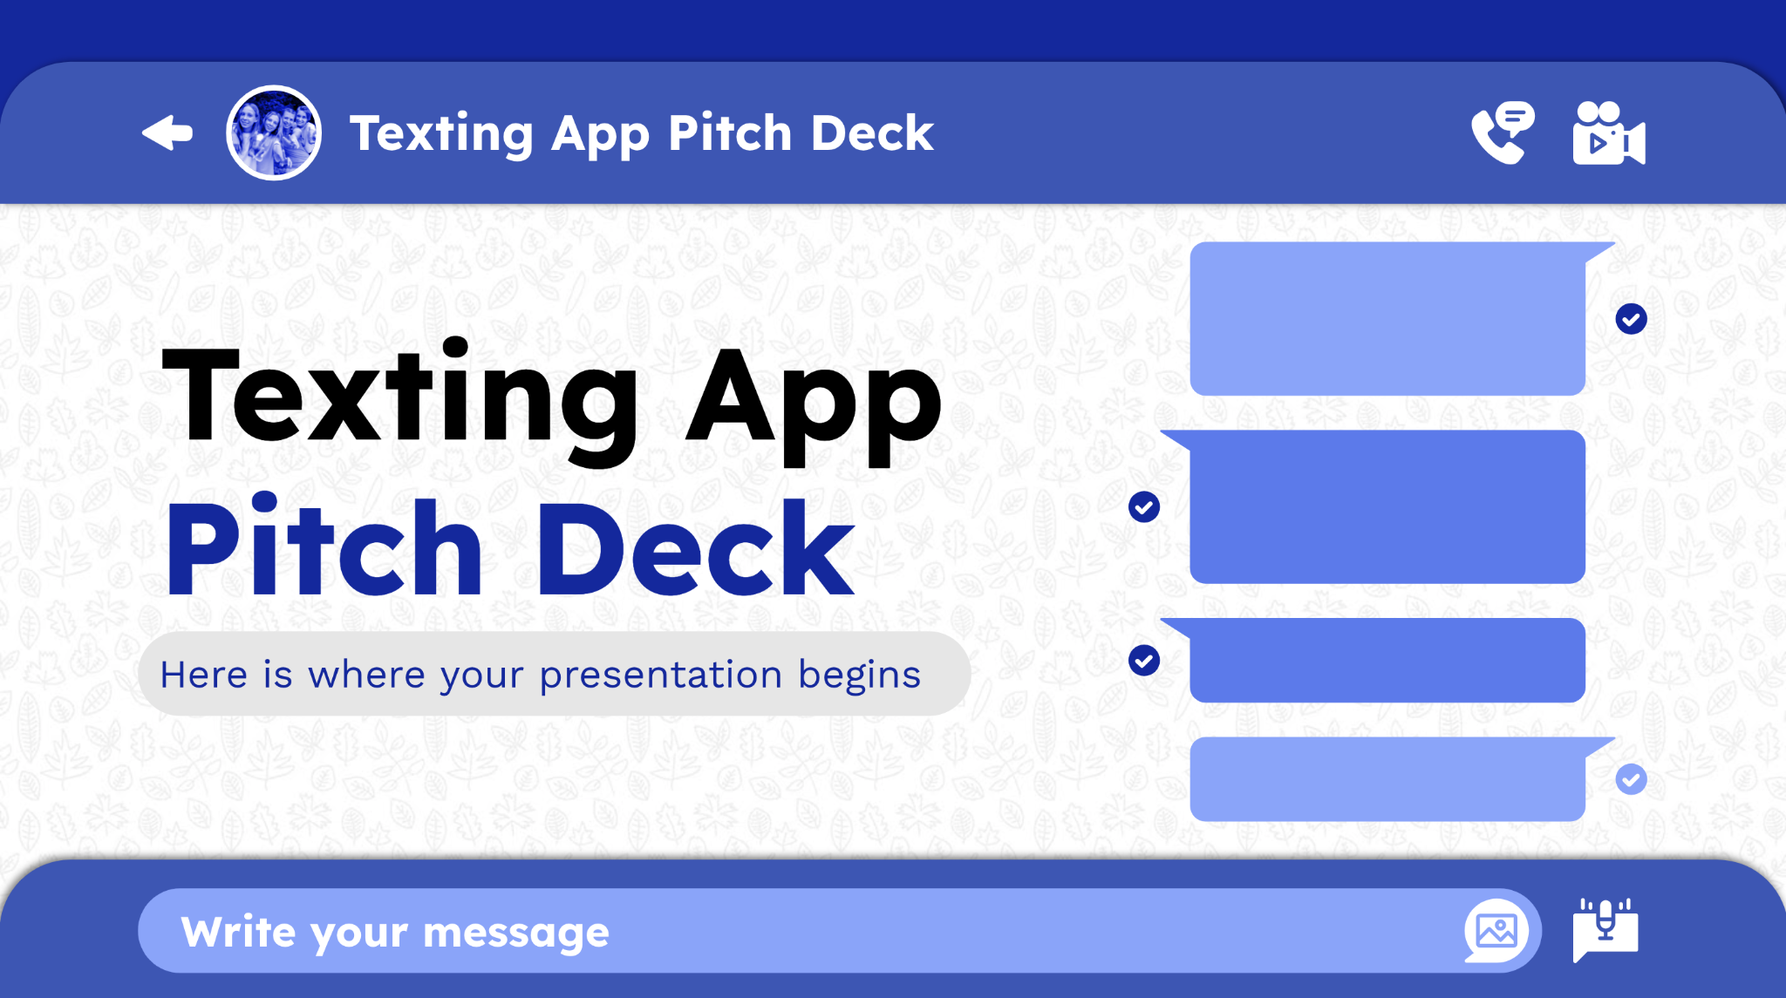
Product Demo
Texting App Pitch Deck
11:25 AM
You can replace the image on the screen with your own work. Just right-click on it and select “Replace image”
Write your message

Slide 33
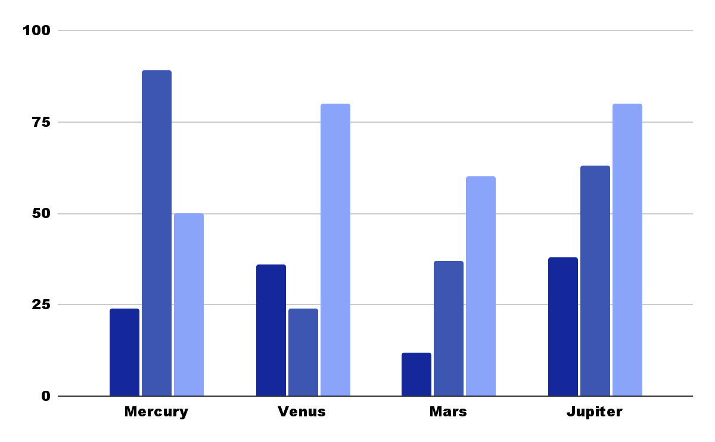
Traction
2019
2020
2021
140,000
Total app downloads
12,000
Registered businesses
$50
Follow the link in the graph to modify its data and then paste the new one here. For more info, click here
Average user savings per deal

Slide 34
Reviews
“Mercury is the closest planet to the Sun”
“Venus is the second planet from the Sun”
“Despite being red, Mars is actually cold”
11:30 AM
11:10 AM
11:39 AM
—Jane Doe
—James Smith
—Jim Carlson
“Jupiter is the biggest planet of them all”
“Neptune is very far away from Earth”
“Earth is the beautiful planet we live on”
11:32 AM
11:54 AM
11:34 AM
—Becca Cox
—Nick Bowman
—Jack Wu

Slide 35
Awards
Mercury
Mercury is a small planet
Venus
Venus is a terribly hot planet
Mars
Despite being red, it’s cold

Slide 36
150,000
Texting App Pitch Deck
11:25 AM
Big numbers may help you catch your audience’s attention
Write your message

Slide 37

11:25 AM
An image is worth a thousand words

Slide 38
Target
Gender
Age range
Men
31-40
60%
40%
Mars is cold
Neptune is far away
Women
41-50
40%
60%
Jupiter is big
Venus is terribly hot
Average spend by customer
$50.00
Average spend by customer

Slide 39
Competitors
11:30 AM
11:10 AM
11:39 AM
Mercury
Venus
Mars
Mercury is the closest planet to the Sun
Venus is the second planet from the Sun
Despite being red, Mars is actually cold
11:32 AM
11:54 AM
11:34 AM
Jupiter
Earth
Neptune
Jupiter is the biggest planet of them all
Earth is the beautiful planet we all live on
Neptune is very far away from Earth

Slide 40
Timing
11:30 AM
Day 01
11:45 AM
Mars is actually a cold place
Day 02
12:00 PM
Mercury is the smallest planet
Day 03
12:15 PM
Neptune is far away from us
Day 04
12:30 PM
Jupiter is the biggest planet
Day 05
Earth is our beautiful planet

Slide 41
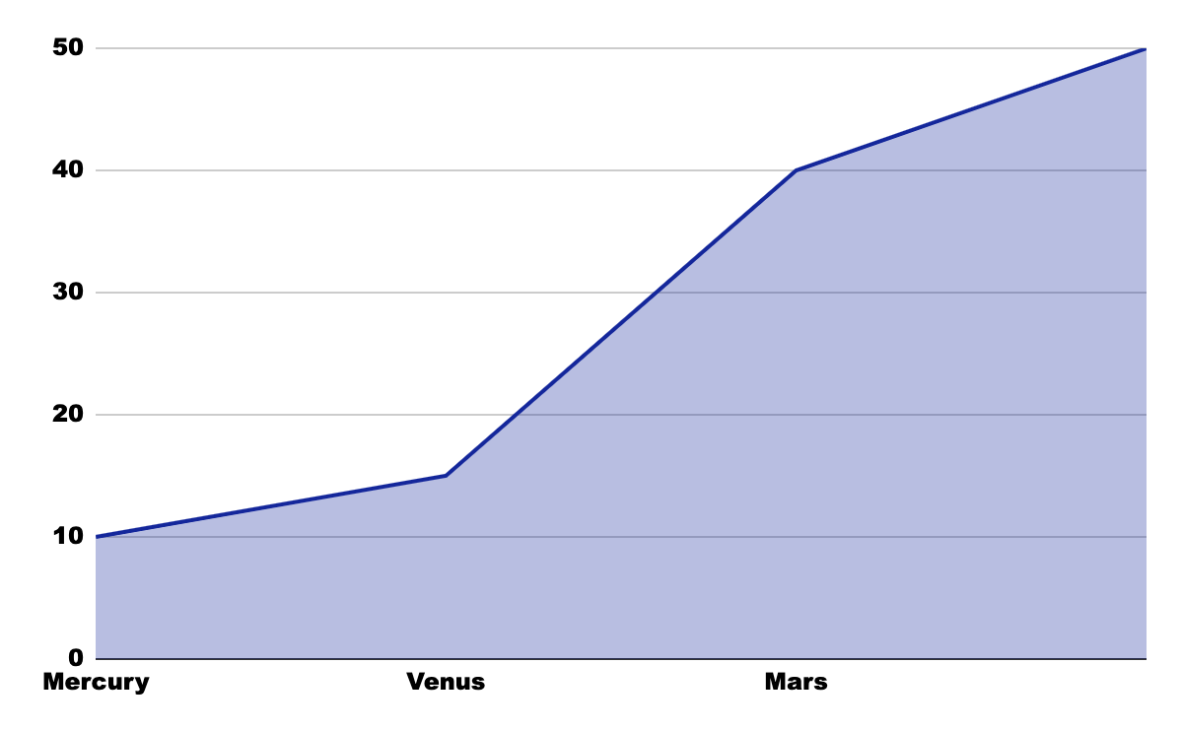
Predicted growth
11:45 AM
$140,000
Expected income for 2020
11:45 AM
100
New employees next year
Follow the link in the graph to modify its data and then paste the new one here. For more info, click here

Slide 42
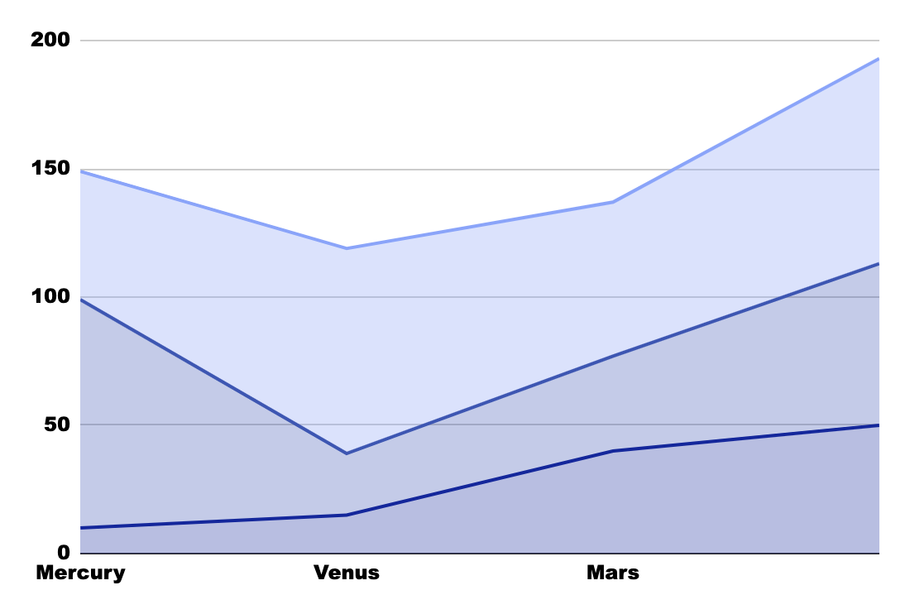
Investment
Mars
Despite being red, it’s cold
Jupiter
Jupiter is the biggest planet
Neptune
Follow the link in the graph to modify its data and then paste the new one here. For more info, click here
Neptune is far away from us

Slide 43
Thanks!
Texting App Pitch Deck
Do you have any questions?
youremail@freepik.com
+34 654 321 321
yourwebsite.com
Please keep this slide for attribution
Write your message

Slide 44
Chat icon pack

Slide 45
Alternative resources
Here’s an assortment of alternative resources whose style fits that of this template

Slide 46
Fonts & colors used
This presentation has been made using the following fonts:
Lexend Deca
(https://fonts.google.com/specimen/Lexend+Deca)
Work Sans
(https://fonts.google.com/specimen/Work+Sans)
#000000
#ffffff
#e6e6e6
#14279b
#3d56b2
#5c7aea
#8aa4f9

